Slide 1
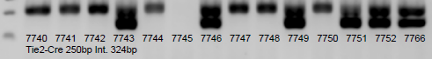
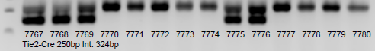
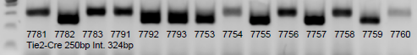
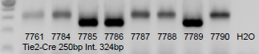
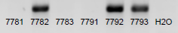
02/08/22
7740 7741 7742 7743 7744 7745 7746 7747 7748 7749 7750 7751 7752 7766 7767 7768 7769 7770 7771 7772 7773 7774 7775 7776 7777 7778 7779 7780 7781 7782 7783 7791 7792 7793 7753 7754 7755 7756 7757 7758 7759 7760 7761 7784 7785 7786 7787 7788 7789 7790 7762 7763 7764 7765 7794 7795 7796 7797 7798 7799 7800 7801 7802 7803 7804 7805 7806 7807 7808 H2O
Tie2-Cre 250bp Int. 324bp
Tie2-Cre 250bp Int. 324bp
F1R 370bp
7740 7741 7742 7743 7744 7745 7746 7747 7748 7749 7750 7751 7752 7766 7767 7768 7769 7770 7771 7772 7773 7774 7775 7776 7777 7778 7779 7780 7781 7782 7783 7791 7792 7793 H2O
F1R 370bp
F2R WT-410bp flox-450bp
EYFP YFP-360bp WT-603bp
RBP2 WT-129bp bf-302bp
UTX WT-700bp uf-1052bp

Slide 2
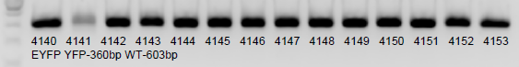
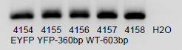
5/14/22
4140 4141 4142 4143 4144 4145 4146 4147 4148 4149 4150 4151 4152 4153 4154 4155 4156 4157 4158 H2O
EYFP YFP-360bp WT-603bp
Tie2-Cre 250bp Int. 324bp
F1R 370bp
F2R WT-410bp flox-450bp
EYFP YFP-360bp WT-603bp
RBP2 WT-129bp bf-302bp
UTX WT-700bp uf-1052bp

Slide 3
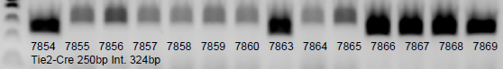
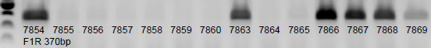
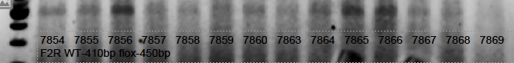
6/24/22
7794 7795 7796 7797 7798 7799 7800 7801 7802 7803 7804 7805 7806 7807 7808 7810 7811 7812 7813 7814 7815 7816 7817 7818 7819 7820 7821 7822 7823 7825 7826 7827 7828 7829 7830 7831 7832 7833 7834 7835 7836 7837 7838 7839 7840 7841 7842 7843 7844 7845 7846 7847 7848 7849 7850 7851 7852 7853 7854 7855 7856 7857 7858 7859 7860 7863 7864 7865 7866 7867 7868 7869 H2O
Tie2-Cre 250bp Int. 324bp
Tie2-Cre 250bp Int. 324bp
F1R 370bp
F2R WT-410bp flox-450bp
EYFP YFP-360bp WT-603bp
RBP2 WT-129bp bf-302bp
UTX WT-700bp uf-1052bp

Slide 4
Tie2-Cre 250bp Int. 324bp
F1R 370bp
F2R WT-410bp flox-450bp
EYFP YFP-360bp WT-603bp
RBP2 WT-129bp bf-302bp
UTX WT-700bp uf-1052bp

Slide 5
Tie2-Cre 250bp Int. 324bp
F1R 370bp
F2R WT-410bp flox-450bp
EYFP YFP-360bp WT-603bp
RBP2 WT-129bp bf-302bp
UTX WT-700bp uf-1052bp

Slide 6
Tie2-Cre 250bp Int. 324bp
F1R 370bp
F2R WT-410bp flox-450bp
EYFP YFP-360bp WT-603bp
RBP2 WT-129bp bf-302bp
UTX WT-700bp uf-1052bp

Slide 7
Tie2-Cre 250bp Int. 324bp
F1R 370bp
F2R WT-410bp flox-450bp
EYFP YFP-360bp WT-603bp
RBP2 WT-129bp bf-302bp
UTX WT-700bp uf-1052bp

Slide 8
Tie2-Cre 250bp Int. 324bp
F1R 370bp
F2R WT-410bp flox-450bp
EYFP YFP-360bp WT-603bp
RBP2 WT-129bp bf-302bp
UTX WT-700bp uf-1052bp

Slide 9
Tie2-Cre 250bp Int. 324bp
F1R 370bp
F2R WT-410bp flox-450bp
EYFP YFP-360bp WT-603bp
RBP2 WT-129bp bf-302bp
UTX WT-700bp uf-1052bp

Slide 10
Tie2-Cre 250bp Int. 324bp
F1R 370bp
F2R WT-410bp flox-450bp
EYFP YFP-360bp WT-603bp
RBP2 WT-129bp bf-302bp
UTX WT-700bp uf-1052bp

Slide 11
Tie2-Cre 250bp Int. 324bp
F1R 370bp
F2R WT-410bp flox-450bp
EYFP YFP-360bp WT-603bp
RBP2 WT-129bp bf-302bp
UTX WT-700bp uf-1052bp

Slide 12
Tie2-Cre 250bp Int. 324bp
F1R 370bp
F2R WT-410bp flox-450bp
EYFP YFP-360bp WT-603bp
RBP2 WT-129bp bf-302bp
UTX WT-700bp uf-1052bp

Slide 13
Tie2-Cre 250bp Int. 324bp
F1R 370bp
F2R WT-410bp flox-450bp
EYFP YFP-360bp WT-603bp
RBP2 WT-129bp bf-302bp
UTX WT-700bp uf-1052bp

Slide 14
Tie2-Cre 250bp Int. 324bp
F1R 370bp
F2R WT-410bp flox-450bp
EYFP YFP-360bp WT-603bp
RBP2 WT-129bp bf-302bp
UTX WT-700bp uf-1052bp

Slide 15
Tie2-Cre 250bp Int. 324bp
F1R 370bp
F2R WT-410bp flox-450bp
EYFP YFP-360bp WT-603bp
RBP2 WT-129bp bf-302bp
UTX WT-700bp uf-1052bp

Slide 16
Tie2-Cre 250bp Int. 324bp
F1R 370bp
F2R WT-410bp flox-450bp
EYFP YFP-360bp WT-603bp
RBP2 WT-129bp bf-302bp
UTX WT-700bp uf-1052bp

Slide 17
Tie2-Cre 250bp Int. 324bp
F1R 370bp
F2R WT-410bp flox-450bp
EYFP YFP-360bp WT-603bp
RBP2 WT-129bp bf-302bp
UTX WT-700bp uf-1052bp

Slide 18
Tie2-Cre 250bp Int. 324bp
F1R 370bp
F2R WT-410bp flox-450bp
EYFP YFP-360bp WT-603bp
RBP2 WT-129bp bf-302bp
UTX WT-700bp uf-1052bp

Slide 19
Tie2-Cre 250bp Int. 324bp
F1R 370bp
F2R WT-410bp flox-450bp
EYFP YFP-360bp WT-603bp
RBP2 WT-129bp bf-302bp
UTX WT-700bp uf-1052bp

Slide 20
Tie2-Cre 250bp Int. 324bp
F1R 370bp
F2R WT-410bp flox-450bp
EYFP YFP-360bp WT-603bp
RBP2 WT-129bp bf-302bp
UTX WT-700bp uf-1052bp

Slide 21
Tie2-Cre 250bp Int. 324bp
F1R 370bp
F2R WT-410bp flox-450bp
EYFP YFP-360bp WT-603bp
RBP2 WT-129bp bf-302bp
UTX WT-700bp uf-1052bp

Slide 22
Tie2-Cre 250bp Int. 324bp
F1R 370bp
F2R WT-410bp flox-450bp
EYFP YFP-360bp WT-603bp
RBP2 WT-129bp bf-302bp
UTX WT-700bp uf-1052bp

Slide 23
Tie2-Cre 250bp Int. 324bp
F1R 370bp
F2R WT-410bp flox-450bp
EYFP YFP-360bp WT-603bp
RBP2 WT-129bp bf-302bp
UTX WT-700bp uf-1052bp

Slide 24
Tie2-Cre 250bp Int. 324bp
F1R 370bp
F2R WT-410bp flox-450bp
EYFP YFP-360bp WT-603bp
RBP2 WT-129bp bf-302bp
UTX WT-700bp uf-1052bp

Slide 25
Tie2-Cre 250bp Int. 324bp
F1R 370bp
F2R WT-410bp flox-450bp
EYFP YFP-360bp WT-603bp
RBP2 WT-129bp bf-302bp
UTX WT-700bp uf-1052bp

Slide 26
Tie2-Cre 250bp Int. 324bp
F1R 370bp
F2R WT-410bp flox-450bp
EYFP YFP-360bp WT-603bp
RBP2 WT-129bp bf-302bp
UTX WT-700bp uf-1052bp

Slide 27
Tie2-Cre 250bp Int. 324bp
F1R 370bp
F2R WT-410bp flox-450bp
EYFP YFP-360bp WT-603bp
RBP2 WT-129bp bf-302bp
UTX WT-700bp uf-1052bp

Slide 28
Tie2-Cre 250bp Int. 324bp
F1R 370bp
F2R WT-410bp flox-450bp
EYFP YFP-360bp WT-603bp
RBP2 WT-129bp bf-302bp
UTX WT-700bp uf-1052bp

Slide 29
Tie2-Cre 250bp Int. 324bp
F1R 370bp
F2R WT-410bp flox-450bp
EYFP YFP-360bp WT-603bp
RBP2 WT-129bp bf-302bp
UTX WT-700bp uf-1052bp

Slide 30
Tie2-Cre 250bp Int. 324bp
F1R 370bp
F2R WT-410bp flox-450bp
EYFP YFP-360bp WT-603bp
RBP2 WT-129bp bf-302bp
UTX WT-700bp uf-1052bp

Slide 31
Tie2-Cre 250bp Int. 324bp
F1R 370bp
F2R WT-410bp flox-450bp
EYFP YFP-360bp WT-603bp
RBP2 WT-129bp bf-302bp
UTX WT-700bp uf-1052bp

Slide 32
Tie2-Cre 250bp Int. 324bp
F1R 370bp
F2R WT-410bp flox-450bp
EYFP YFP-360bp WT-603bp
RBP2 WT-129bp bf-302bp
UTX WT-700bp uf-1052bp

Slide 33
Tie2-Cre 250bp Int. 324bp
F1R 370bp
F2R WT-410bp flox-450bp
EYFP YFP-360bp WT-603bp
RBP2 WT-129bp bf-302bp
UTX WT-700bp uf-1052bp

Slide 34
Tie2-Cre 250bp Int. 324bp
F1R 370bp
F2R WT-410bp flox-450bp
EYFP YFP-360bp WT-603bp
RBP2 WT-129bp bf-302bp
UTX WT-700bp uf-1052bp

Slide 35
Tie2-Cre 250bp Int. 324bp
F1R 370bp
F2R WT-410bp flox-450bp
EYFP YFP-360bp WT-603bp
RBP2 WT-129bp bf-302bp
UTX WT-700bp uf-1052bp

Slide 36
2022 End
FA008 FA009 FA010 4.03
A0040 A0041 A0042 4.10
1850 1851 1856 5.00
F509 F510 F511 4.90
Tie2-Cre 250bp Int. 324bp
F1R 370bp
F2R WT-410bp flox-450bp
EYFP YFP-360bp WT-603bp
RBP2 WT-129bp bf-302bp
UTX WT-700bp uf-1052bp

Slide 37
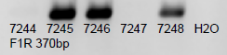
1/7/20
1216 1217 1218 1219 1220 1222 1223 1224 1225 1226 1250 1251 1252 1253 1254 7237 7238 7239 7240 7241 7242 7243 7244 7245 7246 7247 7248 H2O
Tie2-Cre 250bp Int. 324bp
Tie2-Cre 250bp Int. 324bp
F1R 370bp
F2R WT-410bp flox-450bp
EYFP WT-360bp flox-603bp

Slide 38
1/17/20
3139 3167 3168 3169 3170 3171 3172 3173 3174 3175 3176 3177 7249 7250 7251 7252 7253 7254 7255 7256 7257 7258 7259 7260 7261 7262 7263 7264 7265 7266 7267 7268 7269 7270 7271 1??? 2??? 3??? H2O
F2R WT-410bp flox-450bp
Tie2-Cre 250bp Int. 324bp
F1R 370bp
F2R WT-410bp flox-450bp
EYFP WT-360bp flox-603bp

Slide 39
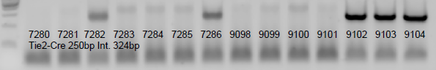
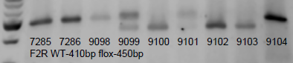
1/24/20
1280 1281 1282 1283 1284 1285 1286 1287 1288 1289 1290 1291 1292 2577 2578 2579 2580 2581 2582 2583 7272 7273 7274 7275 7276 7277 7278 7279 7280 7281 7282 7283 7284 7285 7286 9098 9099 9100 9101 9102 9103 9104 H2O
Tie2-Cre 250bp Int. 324bp
Tie2-Cre 250bp Int. 324bp
F1R 370bp
F2R WT-410bp flox-450bp
EYFP WT-360bp flox-603bp

Slide 40
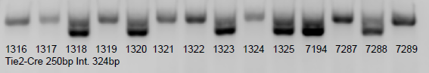
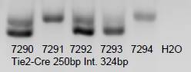
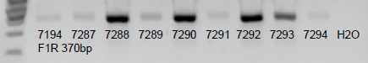
2/7/20
1299 1300 1301 1302 1303 1304 1305 1306 1307 1308 1309 1310 1311 1312 1313 1314 1315 1316 1317 1318 1319 1320 1321 1322 1323 1324 1325 7194 7287 7288 7289 7290 7291 7292 7293 7294 H2O
Tie2-Cre 250bp Int. 324bp
Tie2-Cre 250bp Int. 324bp
F1R 370bp
F2R WT-410bp flox-450bp
EYFP WT-360bp flox-603bp

Slide 41
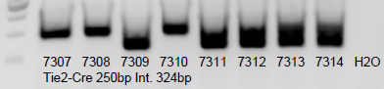
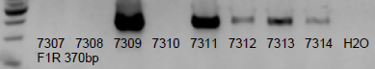
2/26/20
Tie2-Cre 250bp Int. 324bp
F1R 370bp
F2R WT-410bp flox-450bp
EYFP WT-360bp flox-603bp

Slide 42
2/26/20 continue
1299 1306 1309 1310 1313 1317 1319 1320 1323 1324 7287 7288 7289 7290 7291 7292 7293 7294 1326 1327 1328 1329 1330 1331 1332 1333 1334 1335 1336 1337 1338 1339 1340 1341 1342 1343 1344 1345 1346 1347 1348 1349 1350 3148 3149 3190 3191 3192 3193 3194 3196 3197 3198 3199 3200 3201 3202 H2O 7295 7296 7297 7298 7299 7300 7301 7302 7303 7304 7305 7306 7307 7308 7309 7310 7311 7312 7313 7314 H2O
Tie2-Cre 250bp Int. 324bp
Tie2-Cre 250bp Int. 324bp
F1R 370bp
F2R WT-410bp flox-450bp
EYFP WT-360bp flox-603bp

Slide 43
3/6/20
F148 3147 3198 3199 3200 3201 3202 3203 3204 7315 7316 7317 7318 7319 7320 7321 7322 7323 7324 9105 9106 9107 H2O
F2R WT-410bp flox-450bp
Tie2-Cre 250bp Int. 324bp
F1R 370bp
F2R WT-410bp flox-450bp
EYFP WT-360bp flox-603bp

Slide 44
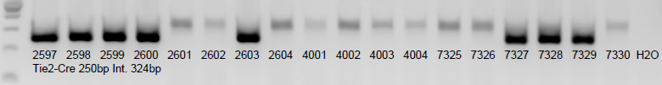
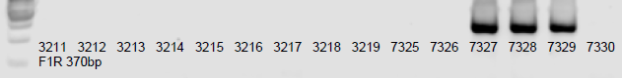
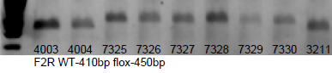
3/26/20
1411 1412 1413 1414 1415 1416 1417 1418 1419 1420 1421 1422 1423 1424 1425 1426 1427 1428 1429 1430 1431 1432 1433 1434 1435 3211 3212 3213 3214 3215 3216 3217 3218 3219 7325 7326 7327 7328 7329 7330 H2O
F1R 370bp
4001 4002 4003 4004
Tie2-Cre 250bp Int. 324bp
F1R 370bp
F2R WT-410bp flox-450bp
EYFP WT-360bp flox-603bp

Slide 45
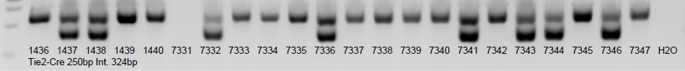
4/7/20
1359 3216 3217 3218 3219 1436 1437 1438 1439 1440 3220 3221 3222 3223 9112 9113 9114 9115 9116 9117 7331 7332 7333 7334 7335 7336 7337 7338 7339 7340 7341 7342 7343 7344 7345 7346 7347 H2O
F2R WT-410bp flox-450bp
Tie2-Cre 250bp Int. 324bp
F1R 370bp
F2R WT-410bp flox-450bp
EYFP WT-360bp flox-603bp

Slide 46
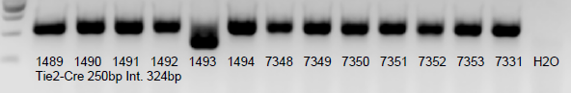
4/22/20
1484 1485 1486 1487 1488 1489 1490 1491 1492 1493 1494 3224 3225 3226 3227 7348 7349 7350 7351 7352 7353 7331 7332 H2O
F2R WT-410bp flox-450bp
Tie2-Cre 250bp Int. 324bp
F1R 370bp
F2R WT-410bp flox-450bp
EYFP WT-360bp flox-603bp

Slide 47
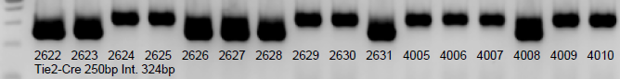
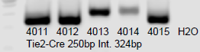
5/4/20
1461 1495 1496 1497 1498 1499 1500 1501 1502 1503 1504 1505 1506 1507 1508 1509 1510 1511 1512 1513 7354 7355 7356 9118 9119 9120 9121 H2O
Tie2-Cre 250bp Int. 324bp
Tie2-Cre 250bp Int. 324bp
F1R 370bp
F2R WT-410bp flox-450bp
EYFP WT-360bp flox-603bp

Slide 48
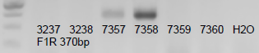
5/25/20
3228 3229 3230 3231 3232 3233 3234 3235 3236 3237 3238 7357 7358 7359 7360 9122 9123 9124 9125 9126 9127 9128 9129 9130 9131 9132 9133 9134 9135 9136 9137 H2O
F2R WT-410bp flox-450bp
Tie2-Cre 250bp Int. 324bp
F1R 370bp
F2R WT-410bp flox-450bp
EYFP WT-360bp flox-603bp

Slide 49
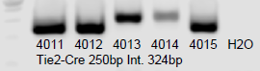
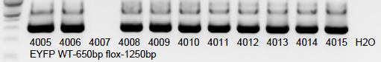
5/27/20
1564 1565 1566 1567 1568 1569 1570 1571 1572 1573 1574 1575 1576 7361 7362 7363 7364 7365 7366 9138 9139 9140 9141 9142 9143 9144 9145 H2O
Tie2-Cre 250bp Int. 324bp
4005 4006 4007 4008 4009 4010 4011 4012 4013 4014 4015 H2O
EYFP WT-650bp flox-1250bp
Tie2-Cre 250bp Int. 324bp
F1R 370bp
F2R WT-410bp flox-450bp
EYFP WT-360bp flox-603bp

Slide 50
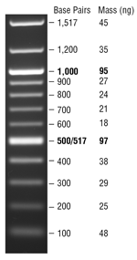
1kb
500bp
Tie2-Cre 250bp Int. 324bp
F1R 370bp
F2R WT-410bp flox-450bp
EYFP WT-360bp flox-603bp

Slide 51
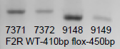
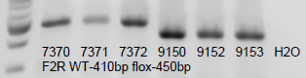
6/23/20
7367 7368 7369 7370 7371 7372 9148 9149 9150 9151 9152 9153 H2O
F2R WT-410bp flox-450bp
Both up and down, both wide and small gel can run F2R
Tie2-Cre 250bp Int. 324bp
F1R 370bp
F2R WT-410bp flox-450bp
EYFP WT-360bp flox-603bp

Slide 52
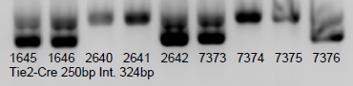
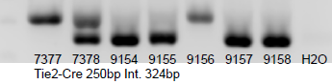
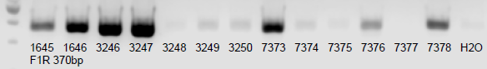
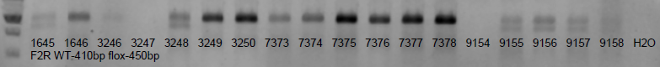
6/27/20
1645 1646 2640 2641 2642 7373 7374 7375 7376 7377 7378 9154 9155 9156 9157 9158 H2O
Tie2-Cre 250bp Int. 324bp
Tie2-Cre 250bp Int. 324bp
F1R 370bp
F2R WT-410bp flox-450bp
EYFP WT-360bp flox-603bp

Slide 53
7/11/20
3251 3252 3253 3254 3255 3256 3257 3258 3259 3260 7379 7380 7381 7382 9159 9160 9161 9162 9163 9164 9165
F2R WT-410bp flox-450bp
Tie2-Cre 250bp Int. 324bp
F1R 370bp
F2R WT-410bp flox-450bp
EYFP WT-360bp flox-603bp

Slide 54
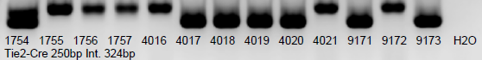
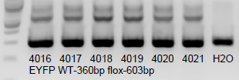
8/8/20
1679 1706 1720 1724 1728 1700 1703 1708 1709 1710 1717 1737 1738 1739 1740 1741 1742 1743 1744 1745 1746 1747 1748 1749 1750 1751 1752 1753 1754 1755 1756 1757 4016 4017 4018 4019 4020 4021 9171 9172 9173 H2O
Tie2-Cre 250bp Int. 324bp
Tie2-Cre 250bp Int. 324bp
F1R 370bp
F2R WT-410bp flox-450bp
EYFP WT-360bp flox-603bp

Slide 55
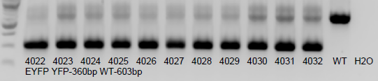
8/18/20
7384 7385 7386 7387 7388 7389 7390 7391 7392 7393 7394 4022 4023 4024 4025 4026 4027 4028 4029 4030 4031 4032 H2O
Tie2-Cre 250bp Int. 324bp
Tie2-Cre 250bp Int. 324bp
F1R 370bp
F2R WT-410bp flox-450bp
EYFP YFP-360bp WT-603bp

Slide 56
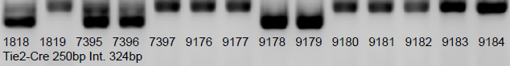
9/5/20
7395 7396 7397 9176 9177 9178 9179 9180 9181 9182 9183 9184 H2O
Tie2-Cre 250bp Int. 324bp
Tie2-Cre 250bp Int. 324bp
F1R 370bp
F2R WT-410bp flox-450bp
EYFP YFP-360bp WT-603bp

Slide 57
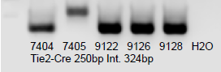
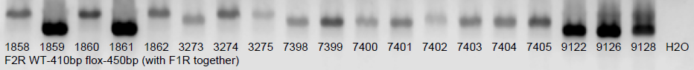
9/19/20
3273 3274 3275 7398 7399 7400 7401 7402 7403 7404 7405 9122 9126 9128 H2O
F2R WT-410bp flox-450bp
Tie2-Cre 250bp Int. 324bp
F1R 370bp
F2R WT-410bp flox-450bp
EYFP YFP-360bp WT-603bp

Slide 58
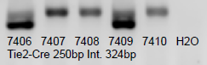
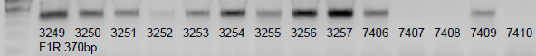
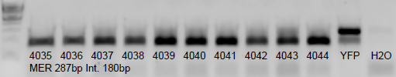
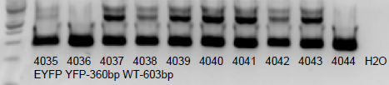
9/30/20
7406 7407 7408 7409 7410
F1R 370bp
Tie2-Cre 250bp Int. 324bp
4035 4036 4037 4038 4039 4040 4041 4042 4043 4044 H2O
EYFP YFP-360bp WT-603bp
F1R 370bp
F2R WT-410bp flox-450bp
EYFP YFP-360bp WT-603bp

Slide 59
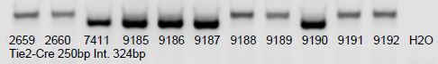
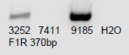
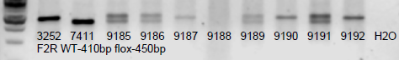
10/9/20
2659 2660 7411 9185 9186 9187 9188 9189 9190 9191 9192 H2O
Tie2-Cre 250bp Int. 324bp
Tie2-Cre 250bp Int. 324bp
F1R 370bp
F2R WT-410bp flox-450bp
EYFP YFP-360bp WT-603bp

Slide 60
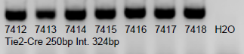
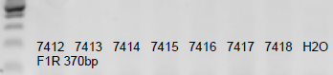


11/2/20
7412 7413 7414 7415 7416 7417 7418 H2O
Tie2-Cre 250bp Int. 324bp
4035 4036 4037 WT H2O
EYFP WT-360bp flox-603bp
Tie2-Cre 250bp Int. 324bp
F1R 370bp
F2R WT-410bp flox-450bp
EYFP YFP-360bp WT-603bp

Slide 61



11/5/20
3276 3277 3278 7419 7420 7421 7422 7423 9188 9204 9205 9206 9207 9208 H2O
F2R WT-410bp flox-450bp
Tie2-Cre 250bp Int. 324bp
F1R 370bp
F2R WT-410bp flox-450bp
EYFP YFP-360bp WT-603bp

Slide 62



11/10/20
7288 7419 7420 7421 7422 7423 9204 9205 9206 9207 9208 Tie2 H2O
Tie2-Cre 250bp Int. 324bp
This is not 7288, should be 7281
3270 F249 3276 3277 3278 7288 9188 fl/+ H2O
F2R WT-410bp flox-450bp
Tie2-Cre 250bp Int. 324bp
F1R 370bp
F2R WT-410bp flox-450bp
EYFP YFP-360bp WT-603bp

Slide 63


12/21/20
4048 4049 4050 4051 4052 4053 4054 4055 4056 4057 4058 4059 4060 4061 4062 4063 4064 4065 4066 4067 4068 4069 4070 4071 4072 4073 4074 H2O
EYFP YFP-360bp WT-603bp
9209 9210 9211 9212 9213 9214 9215 9216 9217 9218 9219 9220 9221 9222 9223 9224 9225 F293 F294 F295 F296 F297 F298 F299 F300 F301 F302 F303 F305 F306 F307 F310 F311 F312 F313 F314 H2O
F2R WT-410bp flox-450bp
Tie2-Cre 250bp Int. 324bp
F1R 370bp
F2R WT-410bp flox-450bp
EYFP YFP-360bp WT-603bp

Slide 64



12/24/20
3279 3280 3281 3282 3283 3284 3285 3286 3287 3288 3289 3290 3291 3292 3293 F293 F294 F295 F296 F297 F316 F317 F318 F319 F320 F321 F322 F323 F324 F325 F326 F327 F328 F329 F330 7281 7282 7287 7424 7425 7426 7427 7428 7429 7430 7431 7432 5534 H2O
F2R WT-410bp flox-450bp
4075 4076 4077 H2O
EYFP YFP-360bp WT-603bp
Tie2-Cre 250bp Int. 324bp
F1R 370bp
F2R WT-410bp flox-450bp
EYFP YFP-360bp WT-603bp

Slide 65








12/29/20
F227 F228 F232 F236 F240 F253 F278 F279 F280 F281 F282 F293 F294 F295 F296 F297 F298 F299 F300 F301 F302 F303 F304 F305 F306 F307 5590 F316 F317 F318 F319 3286 3288 3289 3290 9226 9229 9230 9231 9235 5591 H2O
F2R WT-410bp flox-450bp
Tie2-Cre 250bp Int. 324bp
F1R 370bp
F2R WT-410bp flox-450bp
EYFP YFP-360bp WT-603bp

Slide 66


1/27/21
F338 F339 F348 F349 F350 F351 F352 F353 F354 9064 9067 9239 9240 9241 9242 9243 9244 9245 9246 9247 9248 9249 9250 9253 9255 9256 9257 9258 H2O
F2R WT-410bp flox-450bp
4044 4069 4075 4076 4077 4078 4079 4080 4081 4082 4083 4084 4085 H2O
EYFP YFP-360bp WT-603bp
Tie2-Cre 250bp Int. 324bp
F1R 370bp
F2R WT-410bp flox-450bp
EYFP YFP-360bp WT-603bp

Slide 67




1/27/21
3289 3294 3295 3296 3297 3298 3299 3300 3301 3302 7433 7434 9249 9251 9252 9253 9254 9259 9260 9261 H2O
F2R WT-410bp flox-450bp
4044 4069 4075 4076 4077 4078 4079 4080 4081 4082 4083 4084 4085 H2O
EYFP YFP-360bp WT-603bp
Tie2-Cre 250bp Int. 324bp
F1R 370bp
F2R WT-410bp flox-450bp
EYFP YFP-360bp WT-603bp

Slide 68


3/4/21
4086 4087 4088 4089 4090 4091 H2O
EYFP YFP-360bp WT-603bp
Tie2-Cre 250bp Int. 324bp
F1R 370bp
F2R WT-410bp flox-450bp
EYFP YFP-360bp WT-603bp

Slide 69



3/22/21
F260 F335 F253 F355 F356 F357 F358 F359 F360 F361 F362 F363 F364 F365 F366 F367 F368 F369 F370 F371 F373 F374 F375 F376 F377 F378 F379 F380 F381 F382 F383 F384 F385 F386 F387 F388 F389 F390 F391 F392 F393 F394 F395 F396 F397 F398 F399 F400 F401 F402 F403 F404 F405 F406 F407 F408 F409 F410 F411 F412 F413 F414 F415 F416 F417 F418 7435 7436 7437 7438 7439 7440 7441 7442 7443 H2O
F2R WT-410bp flox-450bp
Tie2-Cre 250bp Int. 324bp
F1R 370bp
F2R WT-410bp flox-450bp
EYFP YFP-360bp WT-603bp

Slide 70

4/20/21
7444 7445 7446 7447 7448 7449 7450 7451 7452 9280 9281 9282 9283 9284 F419 F420 F421 F422 F423 F424 F425 F426 F427 F428 F429 F430 F431 F432 F433 F434 F435 F436 F437 F438 F439 F440 F441 F442 F443 F444 F445 F446 F447 F448 F449 F450 F451 F452 F453 F454 F455 F456 F457 F458 F459 F460 F461 F462
F2R WT-410bp flox-450bp
Tie2-Cre 250bp Int. 324bp
F1R 370bp
F2R WT-410bp flox-450bp
EYFP YFP-360bp WT-603bp

Slide 71


5/20/21
F342 F365 F366 F392 F426 F432 F440 F463 F464 F465 F466 F467 F468 F469 F470 F471 F472 F473 F474 F475 F476 F477 F478 F479 F480 F481 F482 F483 F484 F485 F486 F487 F488 F489 F490 F491 F492 F493 F494 F495 F496 F497 F498 F499 9204 9281 9285 9286 9287 9288 9289 9290 9291 H2O
F2R WT-410bp flox-450bp
Tie2-Cre 250bp Int. 324bp
4093 4094 4095 4096 4097 4098 4099 4100 4101 4102 4103 4104 4105 4106 4107 4108 4109 4110 4111 4112 4113 H2O
EYFP YFP-360bp WT-603bp
F1R 370bp
F2R WT-410bp flox-450bp
EYFP YFP-360bp WT-603bp

Slide 72



5/22/21
3291 3292 3293 3301 3302 3306 3307 3308 3309 3315 3316 3317 3318 3319 3320 3321 3325 3326 F367 F368 F499 F500 F501 F502 F503 F504 F505 F506 F507 F508 7424 7425 7426 7427 7442 7443 7453 7454 7455 7456 7457 7458 7461 7469 7470 7472 7473 7474 7475 7476 7477 7478 7479 7480 7481 7482 7483 7484 1831 1862 3327 3328 3329 3330 3331 H2O
F2R WT-410bp flox-450bp
Tie2-Cre 250bp Int. 324bp
4059 4069 4070 4075 4076 4077 4078 4079 4080 4086 4087 4088 4089 4090 F1R 370bp
F1R 370bp
F2R WT-410bp flox-450bp
EYFP YFP-360bp WT-603bp

Slide 73

6/1/21
FA008 FA009 FA010 FA011 FA012 FA013 A0040 A0041 A0042 A0043 1850 1851 1856 1858 1859 1860 1861 F368 F509 F510 F511 F512 F513 F514 F515 F516 F517 F518 F519 F520 F521 F522 F523 F524 F525 F526 F527 F528 F529 F530 F531 F532 F533 F534 F535 F536 F537 F538 F539 3332 3333 3334 3335 H2O
F2R WT-410bp flox-450bp
Tie2-Cre 250bp Int. 324bp
F1R 370bp
7472 7473 7474 7475 7485 9292 9293 9294 9295 9296 H2O
F2R WT-410bp flox-450bp
F2R WT-410bp flox-450bp
EYFP YFP-360bp WT-603bp

Slide 74



6/25/21
7486 7487 7488 7489 7490 7491 7492 7493 7494 7495 7496 7497 7498 7499 7500 7501 7502 7503 7504 7505 7506 7507 7508 7509 7510 7511 7512 7513 7514 3336 3337 3338 3339 3340 3341 3342 3343 3344 3345 3346 3347 3348 9297 9298 9299 9300 9301 9302 H2O
F2R WT-410bp flox-450bp
Tie2-Cre 250bp Int. 324bp
F1R 370bp
F2R WT-410bp flox-450bp
EYFP YFP-360bp WT-603bp

Slide 75




7/23/21
3355 3356 3357 3358 3359 3360 3361 3362 3363 3364 3365 7515 7516 7517 7518 7519 7520 7521 7522 7523 7524 7525 7526 7527 7528 7529 7530 7531 7532 7533 7534 7535 7536 7537 7538 7539 9295 9296 H2O
F2R WT-410bp flox-450bp
Tie2-Cre 250bp Int. 324bp
F1R 370bp
F2R WT-410bp flox-450bp
EYFP YFP-360bp WT-603bp

Slide 76



8/3/21
A0110 A0111 A0112 A0113 A0114 A0115 A0116 A0117 A0118 A0119 A0120 A0121 A0122 A0123 A0124 A0125 FA031 FA032 FA033 FA034 FA035 FA036 FA037 FA038 3366 3367 3368 3369 3370 7540 7541 7542 7543 7544 7545 7546 7547 7548 7549 7550 7551 7552 7553 7554 7555 7556 7557 7558 7559 7560 7561 7562 7563 7564 9293 H2O
F2R WT-410bp flox-450bp
B0003 WT H2O
RBP2 WT-129bp bf-302bp
Tie2-Cre 250bp Int. 324bp
F1R 370bp
F2R WT-410bp flox-450bp
EYFP YFP-360bp WT-603bp
RBP2 WT-129bp bf-302bp
UTX WT-700bp uf-1052bp

Slide 77



8/17/21
3371 3372 3373 3374 3375 3376 3377 3378 3379 3380 3381 3382 3383 3384 3385 3386 3387 3388 3389 3390 3391 3392 3393 7549 7561 7564 7565 7566 7567 7568 7569 7570 7571 7572 7573 7574 7575 7576 7577 7578 7579 7580 7581 7582 7583 7584 7585 9295 9296 H2O
F2R WT-410bp flox-450bp
Tie2-Cre 250bp Int. 324bp
F1R 370bp
U0002 WT H2O
UTX WT-700bp uf-1052bp
F2R WT-410bp flox-450bp
EYFP YFP-360bp WT-603bp
RBP2 WT-129bp bf-302bp
UTX WT-700bp uf-1052bp

Slide 78
8/27/21
A0138 A0139 A0140 A0141 A0142 A0143 A0144 FA043 FA047 FA048 FA049 FA050 FA051 FA052 FA053 FA054 7586 7587 7588 7589 7590 7591 7592 7593 7594 7595 9303 9306 9307 9308 9309 9310 9311 H2O
F2R WT-410bp flox-450bp
Tie2-Cre 250bp Int. 324bp
F1R 370bp
F2R WT-410bp flox-450bp
EYFP YFP-360bp WT-603bp
RBP2 WT-129bp bf-302bp
UTX WT-700bp uf-1052bp

Slide 79



9/23/21
7586 7596 7597 7598 7599 7600 7601 7602 7603 7604 7605 7606 7607 7608 7609 7610 7611 7612 7613 7614 7615 7616 7617 7618 7619 7620 7621 7622 7623 7624 7625 7626 7627 7628 7629 7630 7631 7632 7633 7634 7635 7636 7637 7638 7639 7640 7641 7642 7643 7644 7645 7646 7647 7648 H2O
Tie2-Cre 250bp Int. 324bp
Tie2-Cre 250bp Int. 324bp
F1R 370bp
F2R WT-410bp flox-450bp
EYFP YFP-360bp WT-603bp
RBP2 WT-129bp bf-302bp
UTX WT-700bp uf-1052bp

Slide 80



10/16/21
7586 7596 7597 7598 7599 7600 7601 7602 7603 7604 7605 7606 7607 7608 7609 7610 7611 7612 7618 7619 7620 7621 7622 7623 7624 7625 7626 7627 7628 7629 7630 7631 7632 7633 7634 7635 7636 7637 7638 7639 7640 7641 7642 7643 7644 7645 7646 7647 7648 7675 7676 7677 7678 7679 7680 7681 WT H2O
F2R WT-410bp flox-450bp
7649 7650 7651 7652 7653 7654 7655 7656 7657 7658 7659 7660 7661 7662 7663 7664 7665 7666 7667 7668 7669 7670 7671 7672 7673 7674 7682 7683 7684 7685 7686 7687 7675 7676 7677 7678 7679 7680 7681 H2O
Tie2-Cre 250bp Int. 324bp
4114 4115 4116 4117 4118 4119 4120 4121 4129 4130 4131 4132 4133 4134 4135 4136 4137 4138 4117+ H2O
EYFP WT-650bp flox-1250bp
Tie2-Cre 250bp Int. 324bp
F1R 370bp
F2R WT-410bp flox-450bp
EYFP YFP-360bp WT-603bp
RBP2 WT-129bp bf-302bp
UTX WT-700bp uf-1052bp

Slide 81


11/7/21
7599 7613 7614 7615 7616 7617 7624 7625 7627 7628 7641 7642 7666 7667 7668 7669 7674 7675 7676 7677 7678 7679 7680 7681 7682 7683 7684 7685 H2O
F2R WT-410bp flox-450bp
FA056 FA088 FA089 3419 3420 3425 3426 3427 3428 3429 7688 7689 7690 7691 7692 7693 7694 7695 7696 7697 7698 7699 7700 7701 7702 7703 7704 7705 7706 7707 7708 7709 7710 7711 7712 7713 7714 7715 7716 7717 7718 7719 7720 7721 7722 7723 7724 7725 7726 7728 7729 7730 H2O
Tie2-Cre 250bp Int. 324bp
Tie2-Cre 250bp Int. 324bp
F1R 370bp
F2R WT-410bp flox-450bp
EYFP YFP-360bp WT-603bp
RBP2 WT-129bp bf-302bp
UTX WT-700bp uf-1052bp

Slide 82

11/8/21 redo F2R with old cDNA from yesterday and new prepared from same tissue, and try two dose for cDNA with new cDNA. Seems no water is not good, but 6ul/30ul total is ok.
Next try 2-5ul/15ul, with some new tissue
7674 7682 7683 7684 7685 7729 WT 7674 7682 7683 7684 7685 7729 H2O 7674 7682 7683 7684 7685 7729 H2O
old cDNA 6ul new 6ul new 12ul
F2R WT-410bp flox-450bp
Tie2-Cre 250bp Int. 324bp
F1R 370bp
F2R WT-410bp flox-450bp
EYFP YFP-360bp WT-603bp
RBP2 WT-129bp bf-302bp
UTX WT-700bp uf-1052bp

Slide 83


11/19/21
3430 3431 3432 3433 3434 3435 3436 3437 3438 3439 3440 3441 3442 7693 7694 7697 7698 7699 7700 7701 7702 7703 7704 7705 7706 7707 7708 7709 7710 7711 7712 7713 7714 7715 7716 7717 7718 7723 7724 7725 7727 7728 7729 7730 7731 7732 7733 7734 7735 7736 7737 7738 7739 H2O
F2R WT-410bp flox-450bp
Tie2-Cre 250bp Int. 324bp
F1R 370bp
F2R WT-410bp flox-450bp
EYFP YFP-360bp WT-603bp
RBP2 WT-129bp bf-302bp
UTX WT-700bp uf-1052bp

